Slide 1
BUT, WHY?
ROAD TRAFFIC ANALYSIS

Slide 2
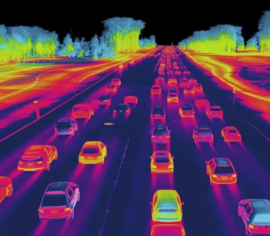
Transportation planning
Road capacity analysis
Traffic signal optimization
Congestion management

Slide 3
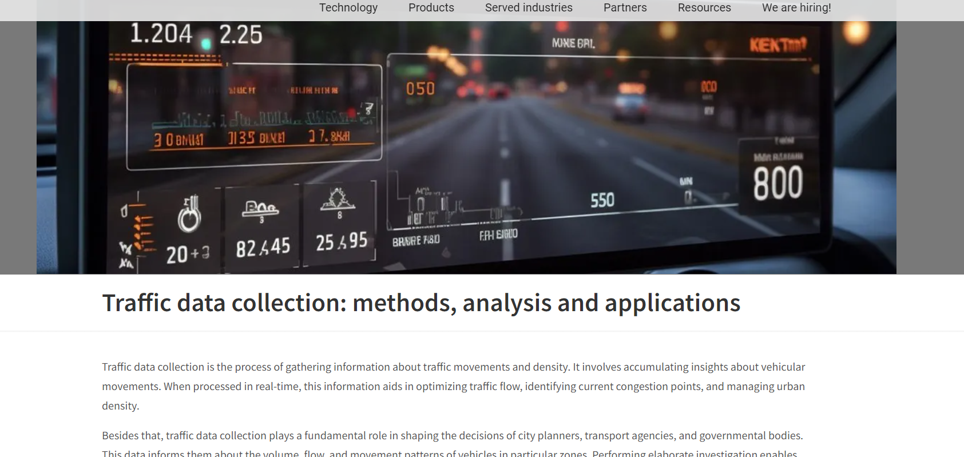
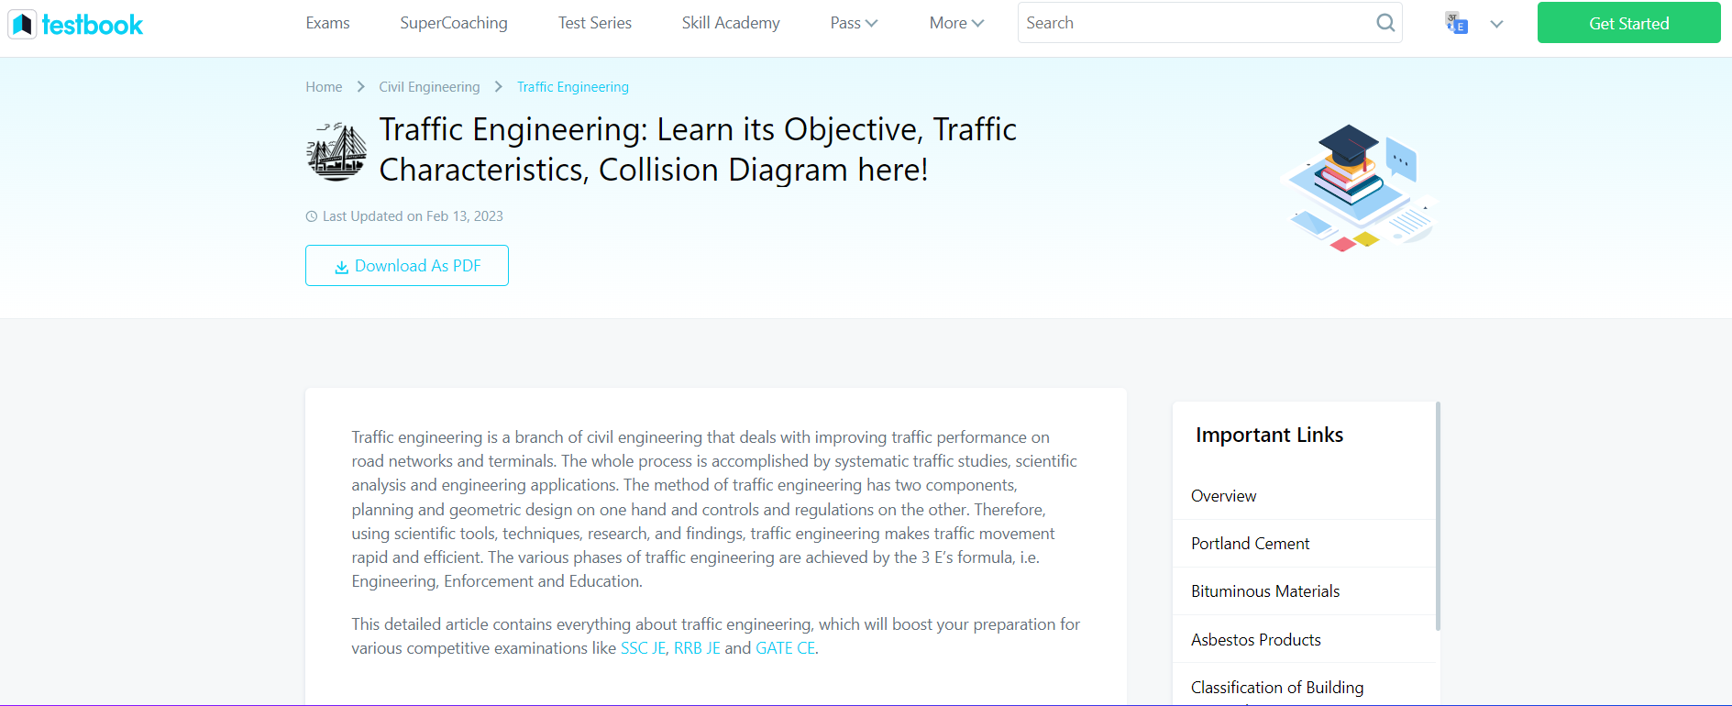
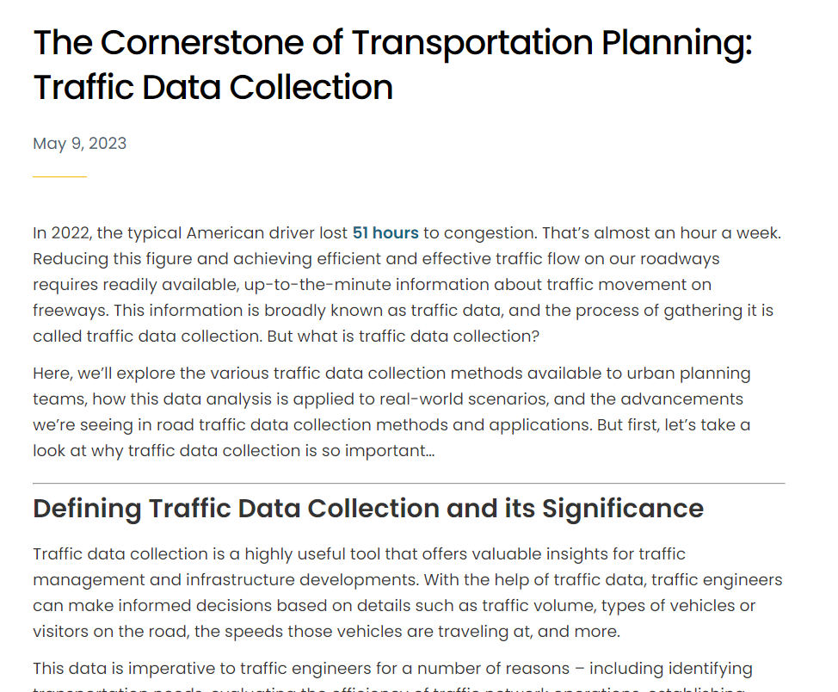
https://avutec.com/traffic-data-collection-methods-analysis-and-applications/
https://testbook.com/civil-engineering/traffic-engineering
https://www.wejo.com/resources/the-cornerstone-of-transportation-planning-traffic-data-collection

Slide 4
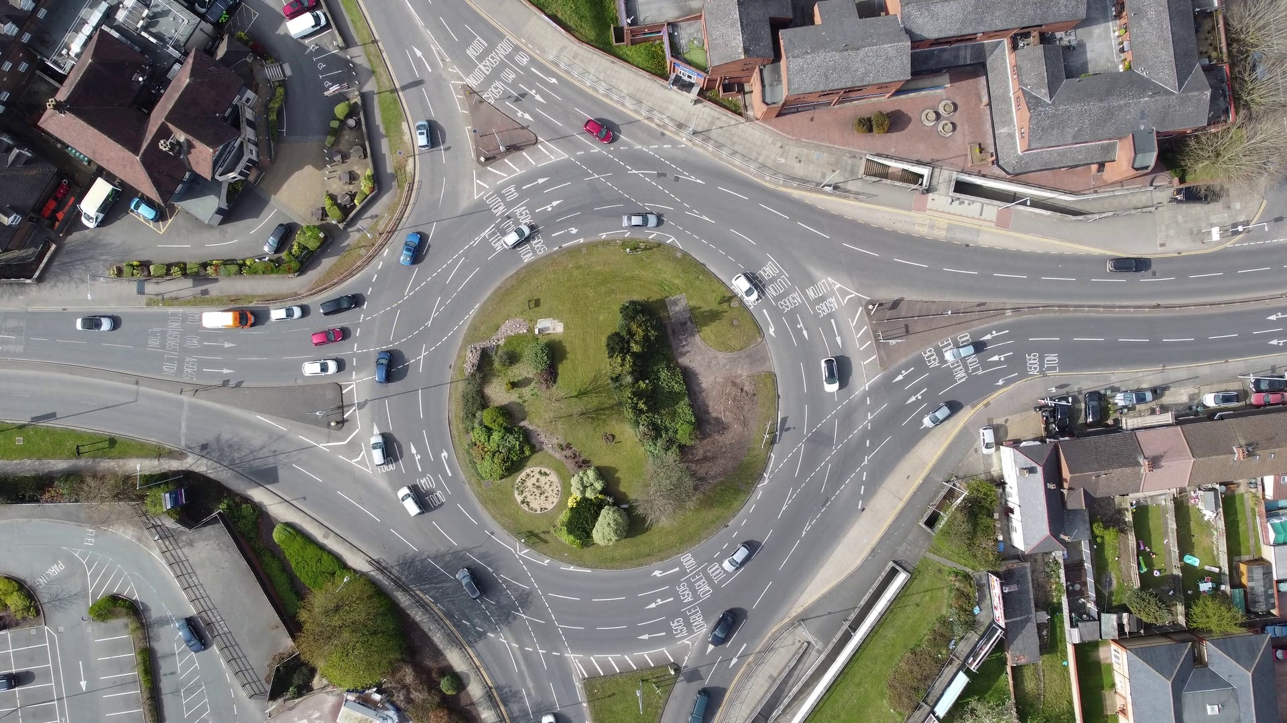

Slide 5
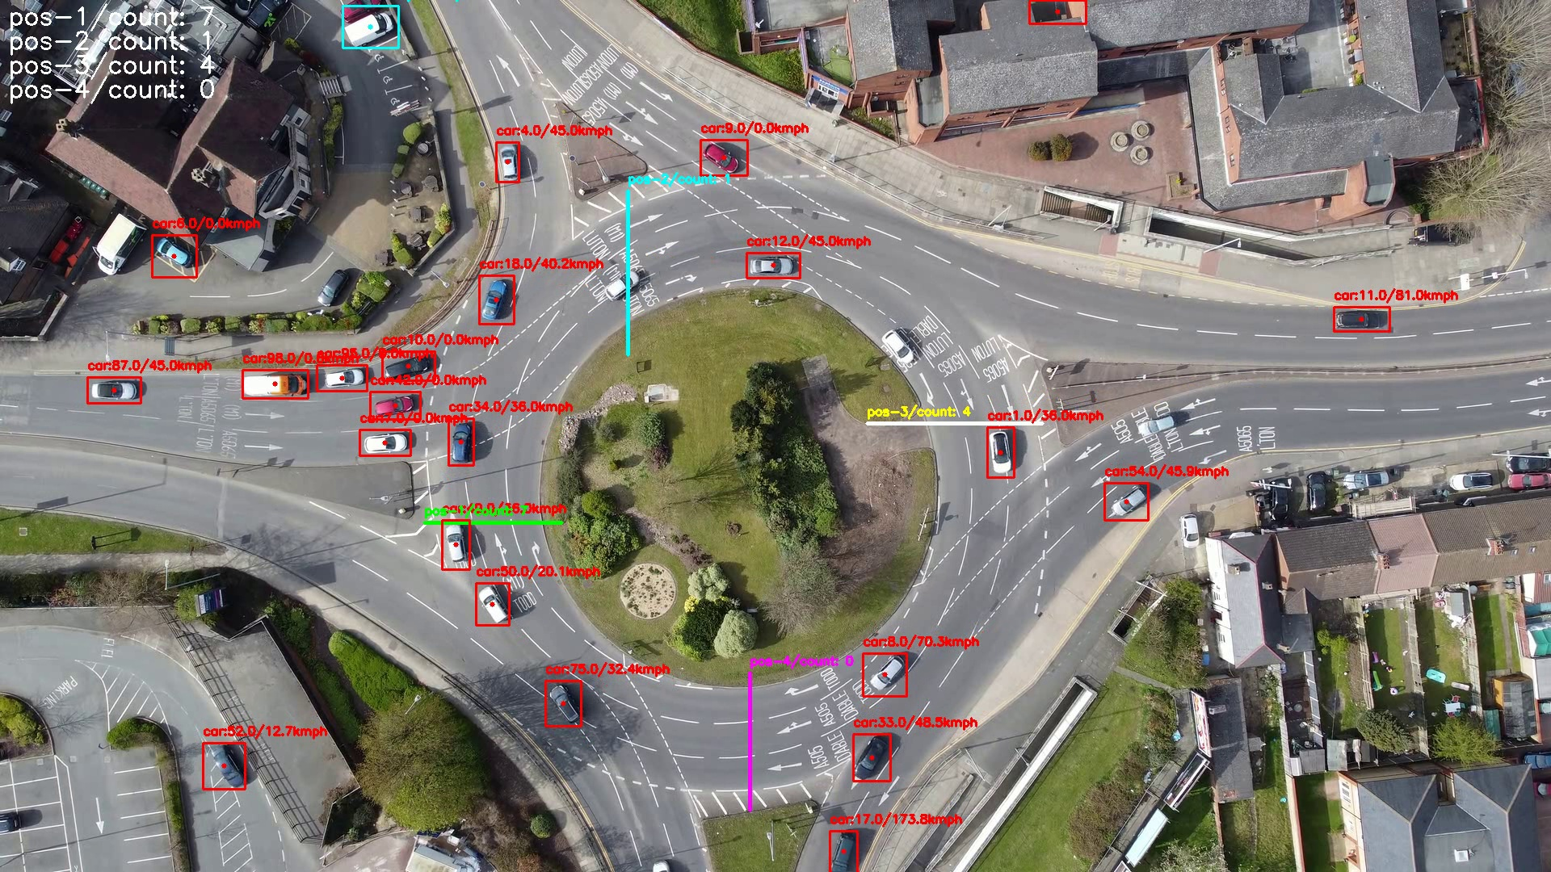
Vehicle count at different positions
Diff. positional ROI
Object with class:trackingID/speed

Slide 6

Count
YOLOv10
Speed
BBoxes
OC SORT tracker
Tracking ID
Trail
Heatmap

Slide 7
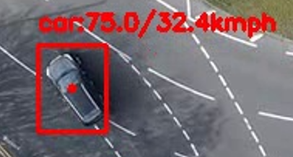
Tracking id [ OC SORT tracker ]
Class name
Speed
BBox [ YOLOv10 ]
Centroid of BBox
OC SORT : https://github.com/mikel-brostrom/boxmot
YOLOv10: https://github.com/THU-MIG/yolov10

Slide 8


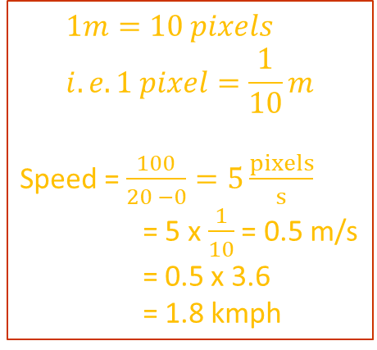

Speed = $\frac{distance}{ t2 – t1}$
$$1m=10 pixels \\ i.e. 1 pixel=\frac{1}{10}m$$
Speed = $\frac{100}{20 −0}=5\frac{pixels}{s}$
= 5 x $\frac{1}{10}$ = 0.5 m/s
= 0.5 x 3.6
= 1.8 kmph
100 pixels
t₁ = 0 s
t₂ = 20 s

Slide 9
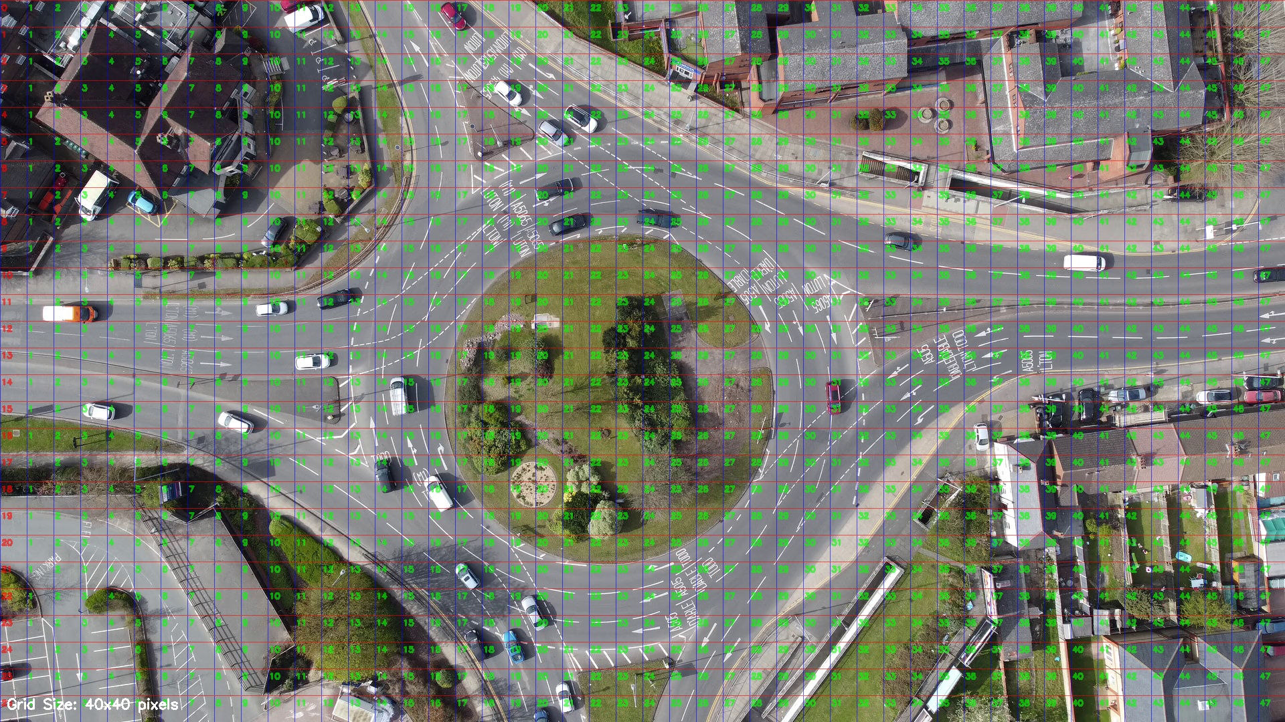

Slide 10
THANK YOU FOR YOUR TIME

